Slide 1
Time Complexity

Slide 2
Time Complexity
The Time Complexity of an algorithm quantifies the amount of time taken by an algorithm.
It estimates the time complexity of an algorithm by counting the number of operations performed by the algorithm.

Slide 3

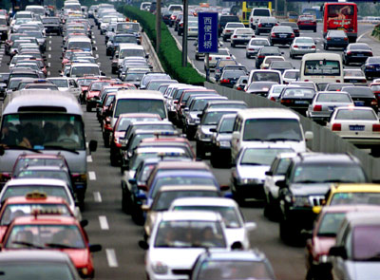
Time Complexity
Best Case Scenario:- Traffic gets over soon and he can reach his friend’s home in 10 minutes.
Worst Case Scenario:- Traffic may continue for three hours more.

Slide 4
Example
For Example,
if 5>3:
print(“True”)
else:
print(“False”)
Time Complexity for the Given Program:
O(1)

Slide 5
Example
A = [2, 4, 6, 7, 9]
Task:- To search 2 in the list.
Sol:- Start with the 0th index and iterate until 2 is found.
This is called Best Case Scenario.
Task:- To search for 9 in the list.
Sol:- Start with the 0th index to the last index.
This is called Worst Case Scenario.

Slide 6
Why Time Complexity is Important?
Number of Records
O(1)
O(n)
O(n^2)
O(n^3)
5
6
7
1ms
1ms
1ms
5ms
6ms
7ms
25ms
36ms
49ms
125ms
216ms
343ms
5000
1ms
5000ms = 5 sec
25*10^6= 7 hrs
125*10^9 = 4 yrs

